Slide 2
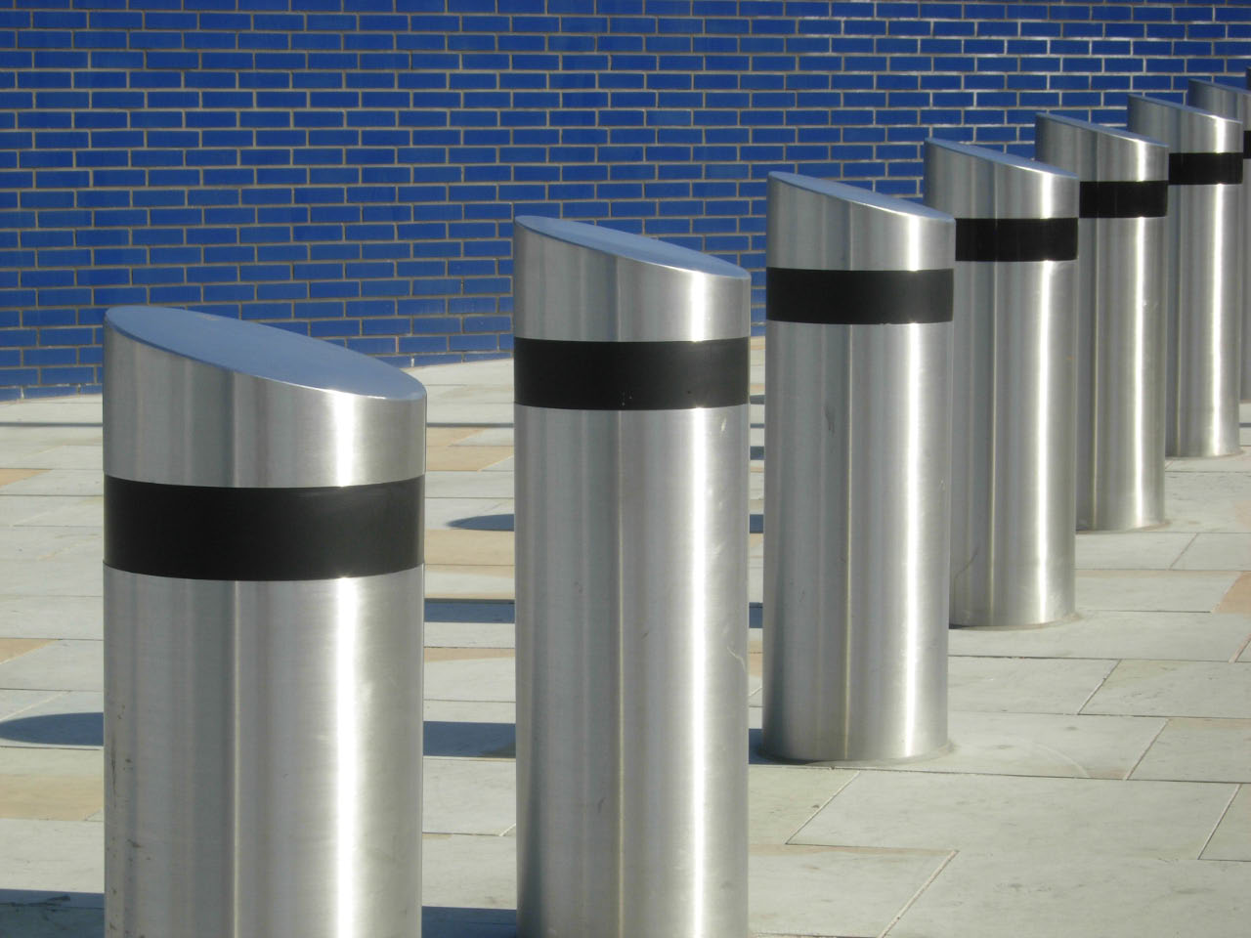
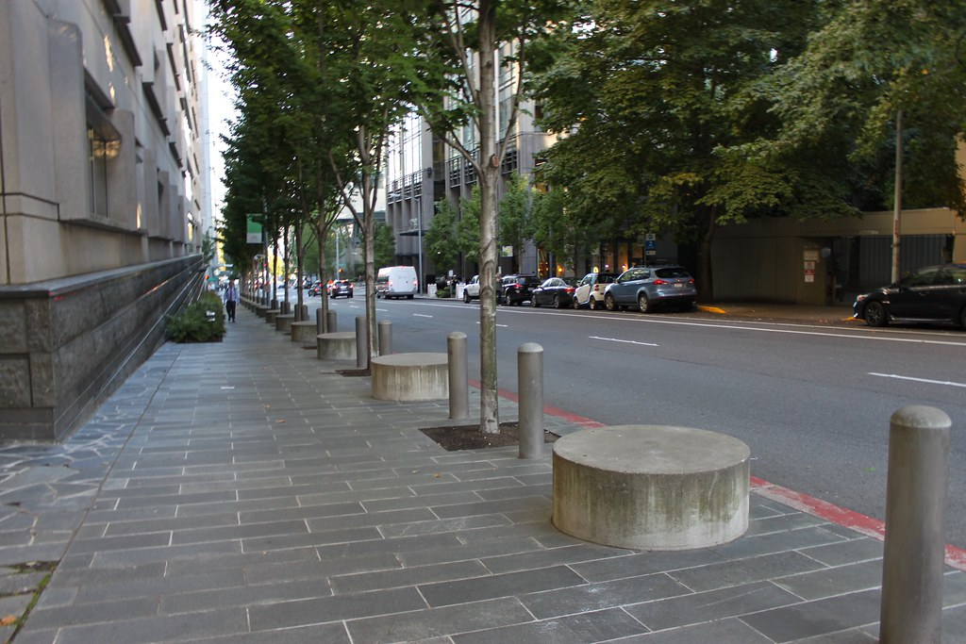
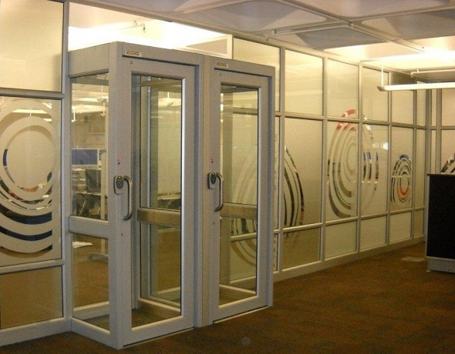
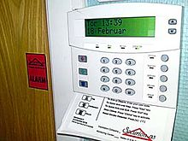

Physical Security
Bollards, barricades, Fencing
Mantraps
DMZs
Alarms
Signage

Slide 3
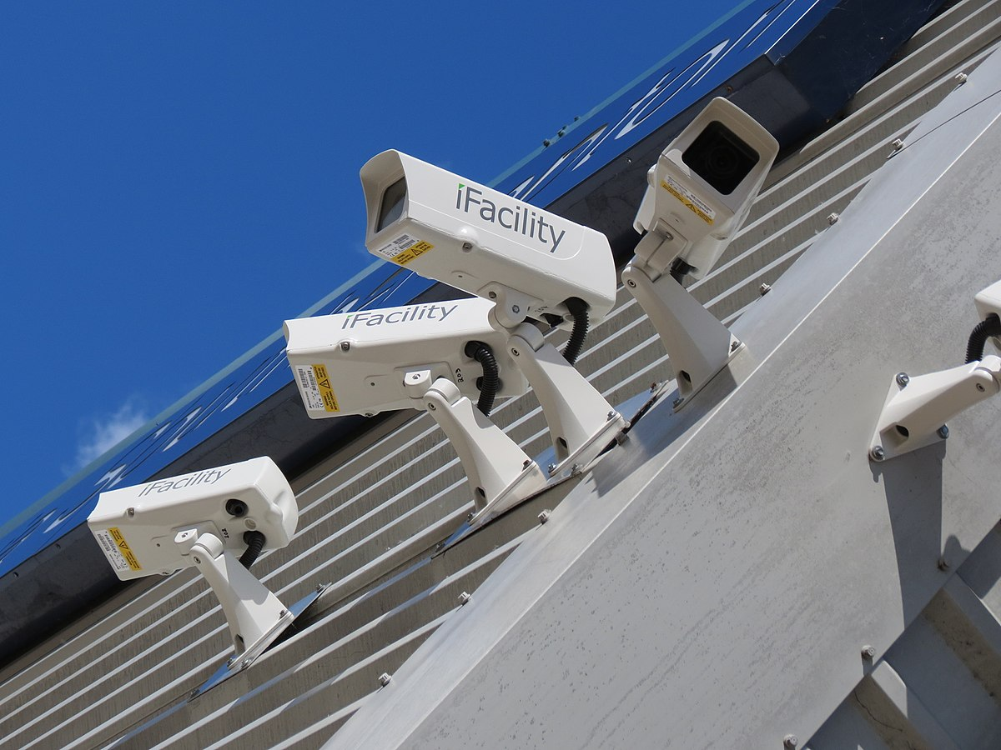
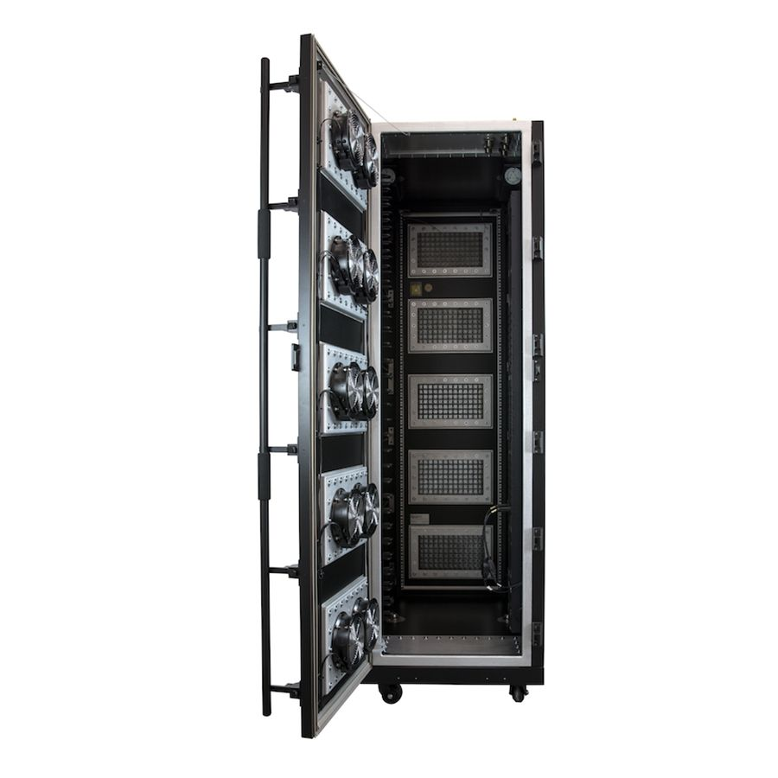
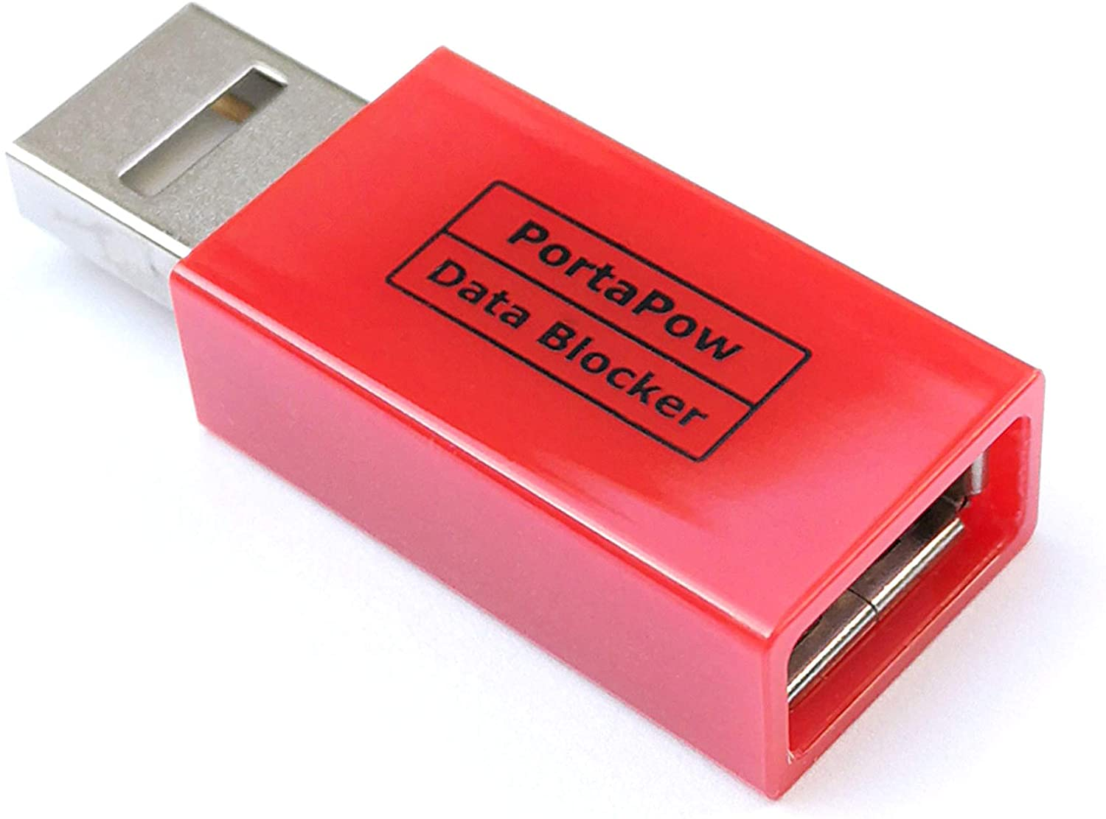
Physical Security
Cameras and CCTCV
Motion recognition
Object detection
Faraday Cage
USB data blockers
Protect cable distribution

Slide 4
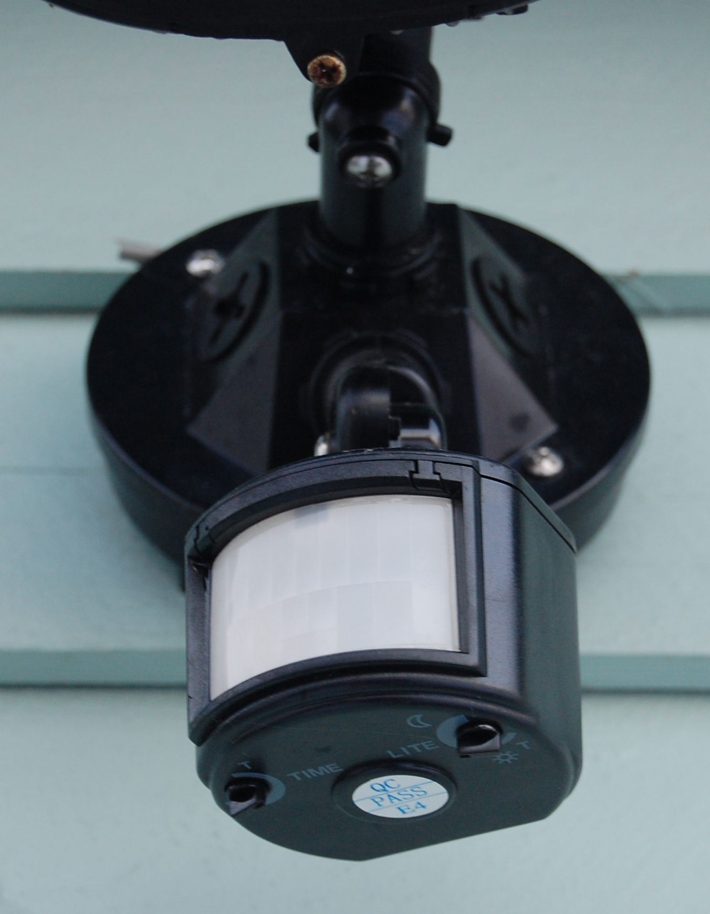
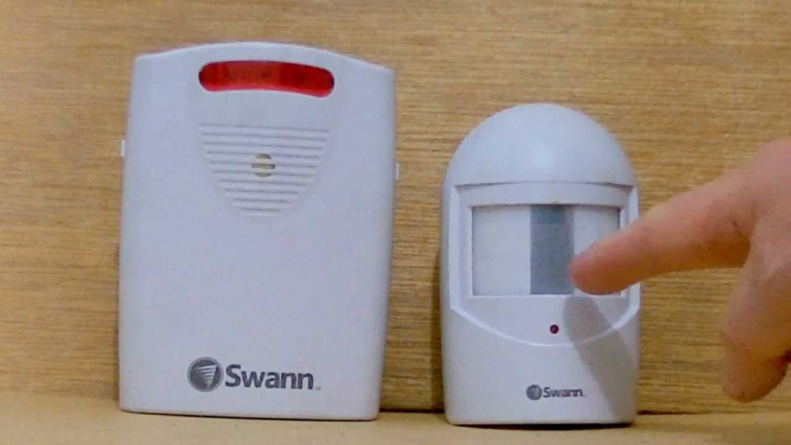

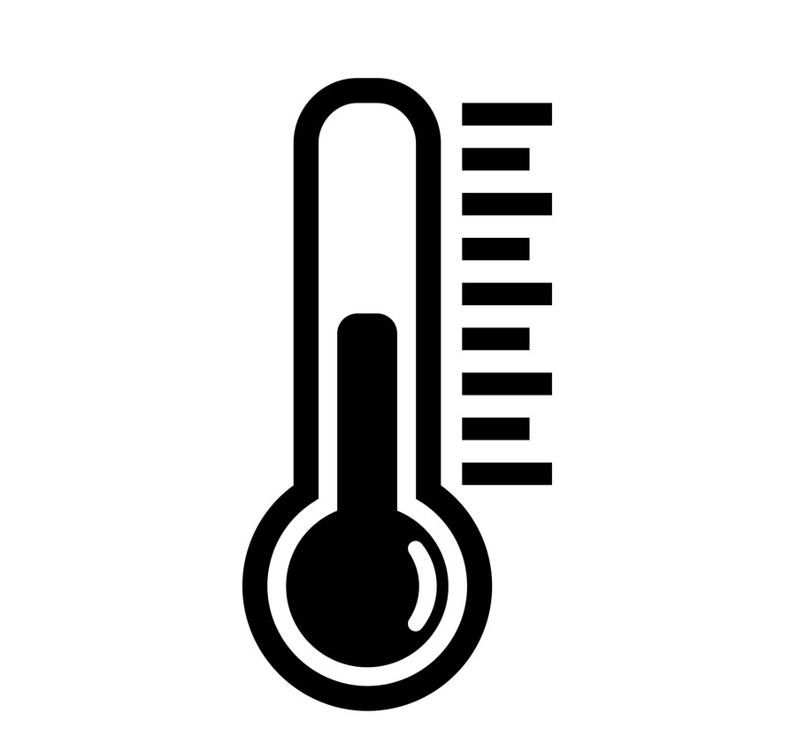
Physical Security - Sensors
Motion detectors
Noise detectors
Moisture detectors
Temperature monitoring
Proximity reader

Slide 5

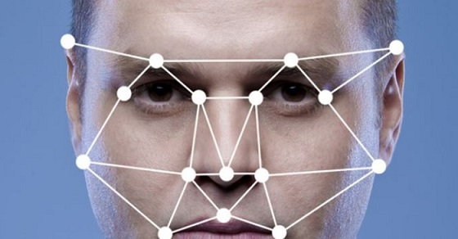
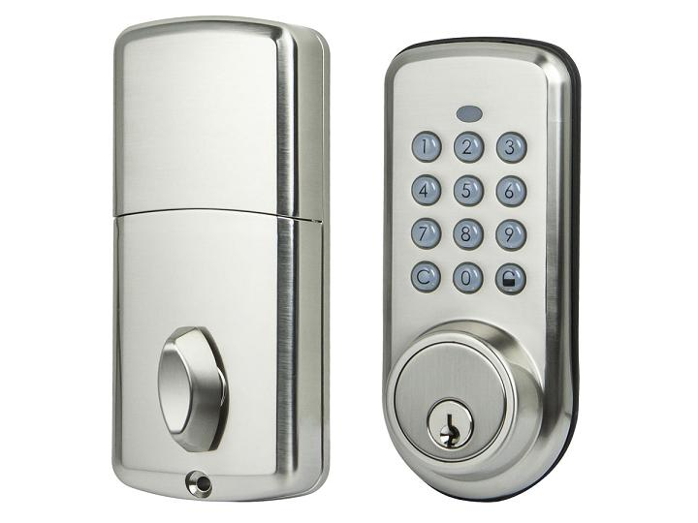
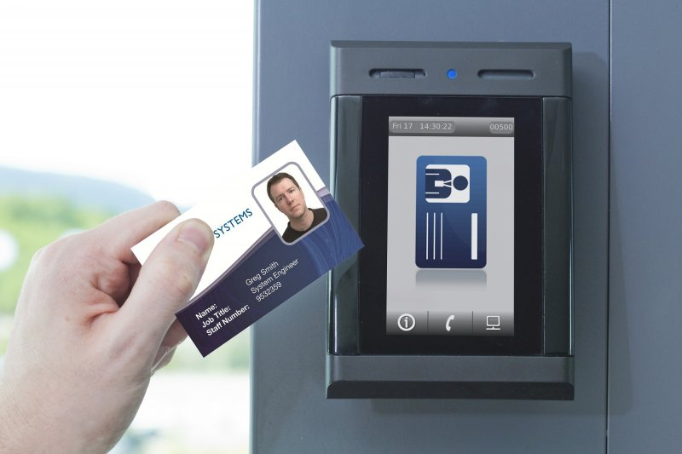
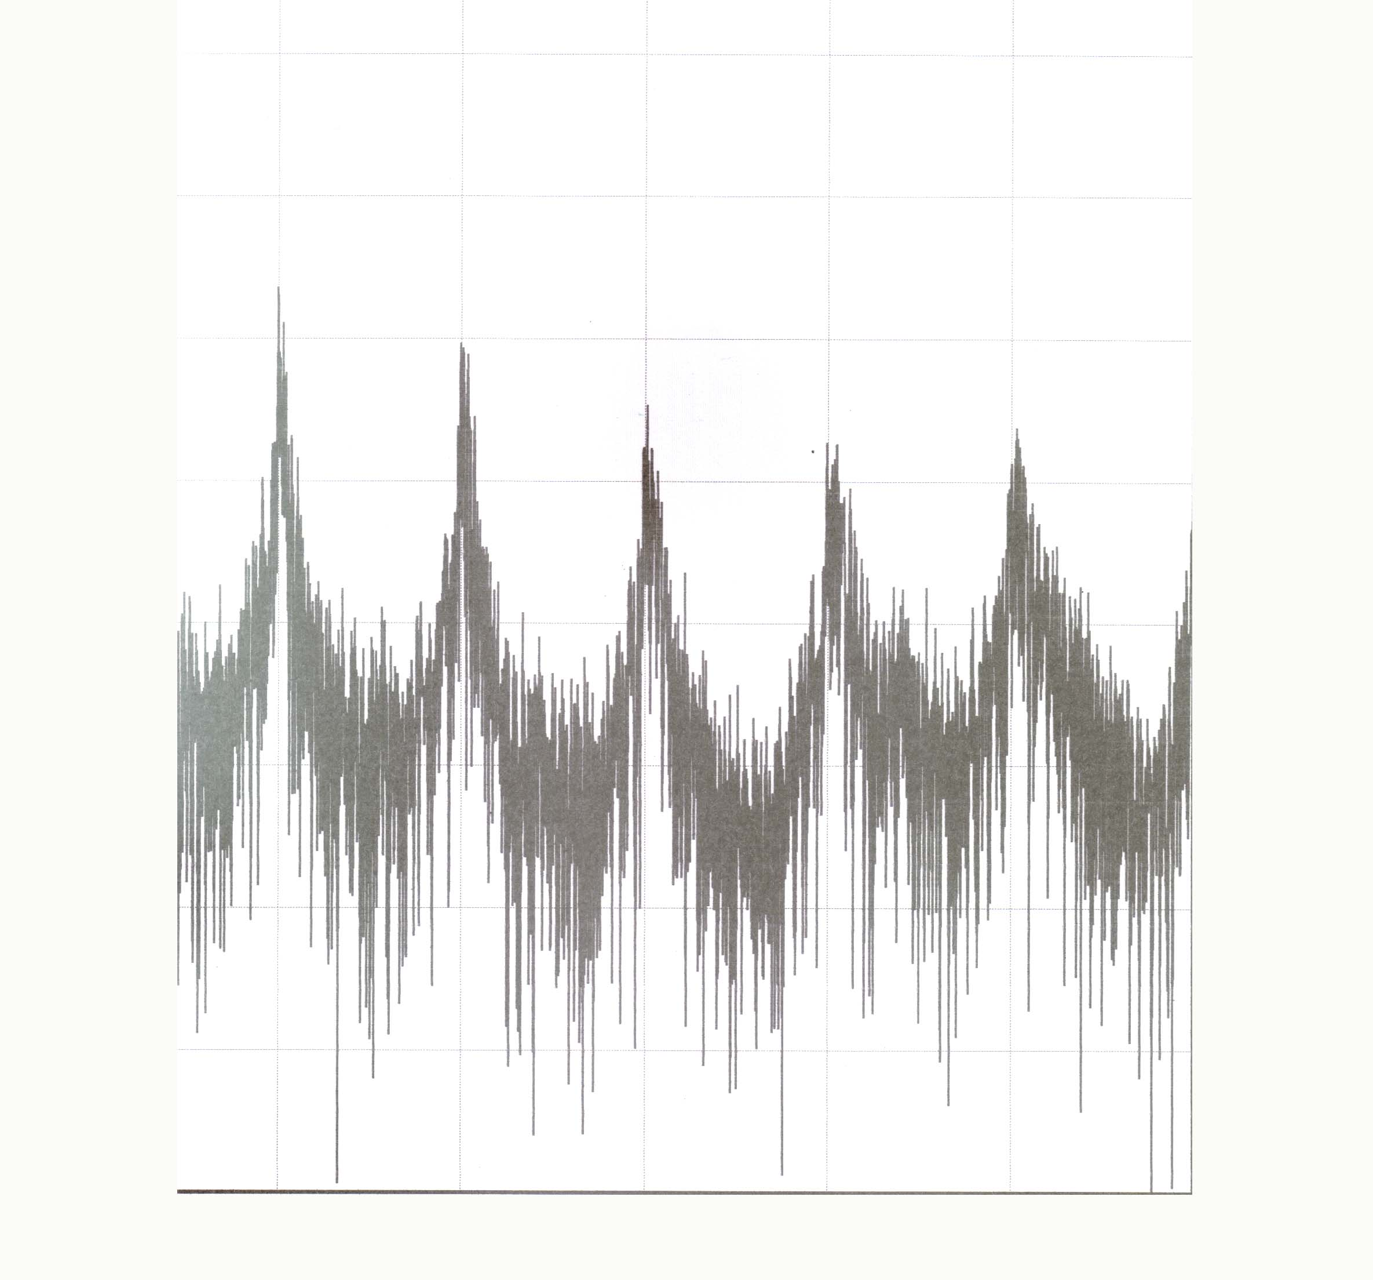

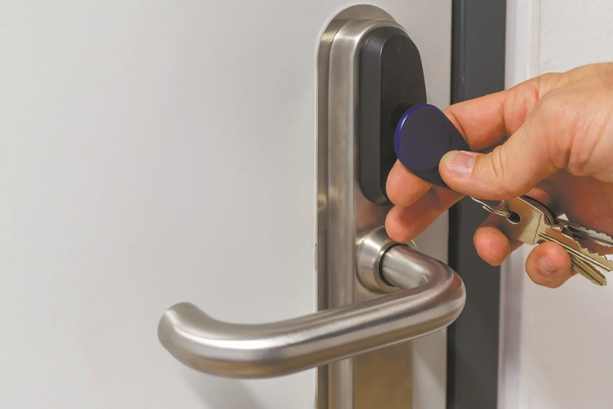
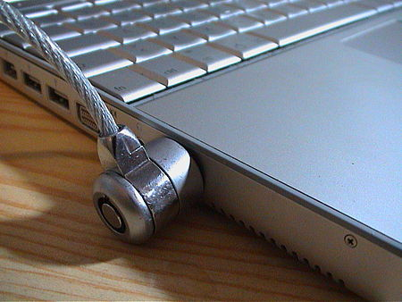
Physical Security - Locks
Biometrics
Electronic
Smart cards
PIN
Key fob
Physical
Cable Locks
Notes:
Electronic PIN lock also has a physical lock

Slide 6




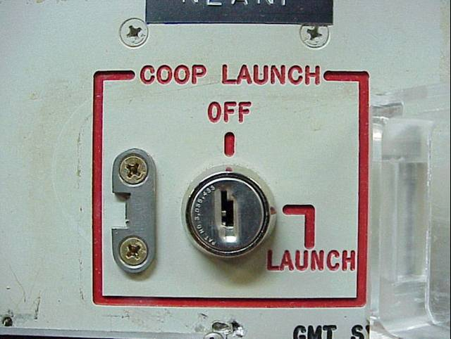
Physical Security - Personnel
Guards
Reception
Visitor logs
Access control roster
Robot Sentries
Two-person control

Slide 7


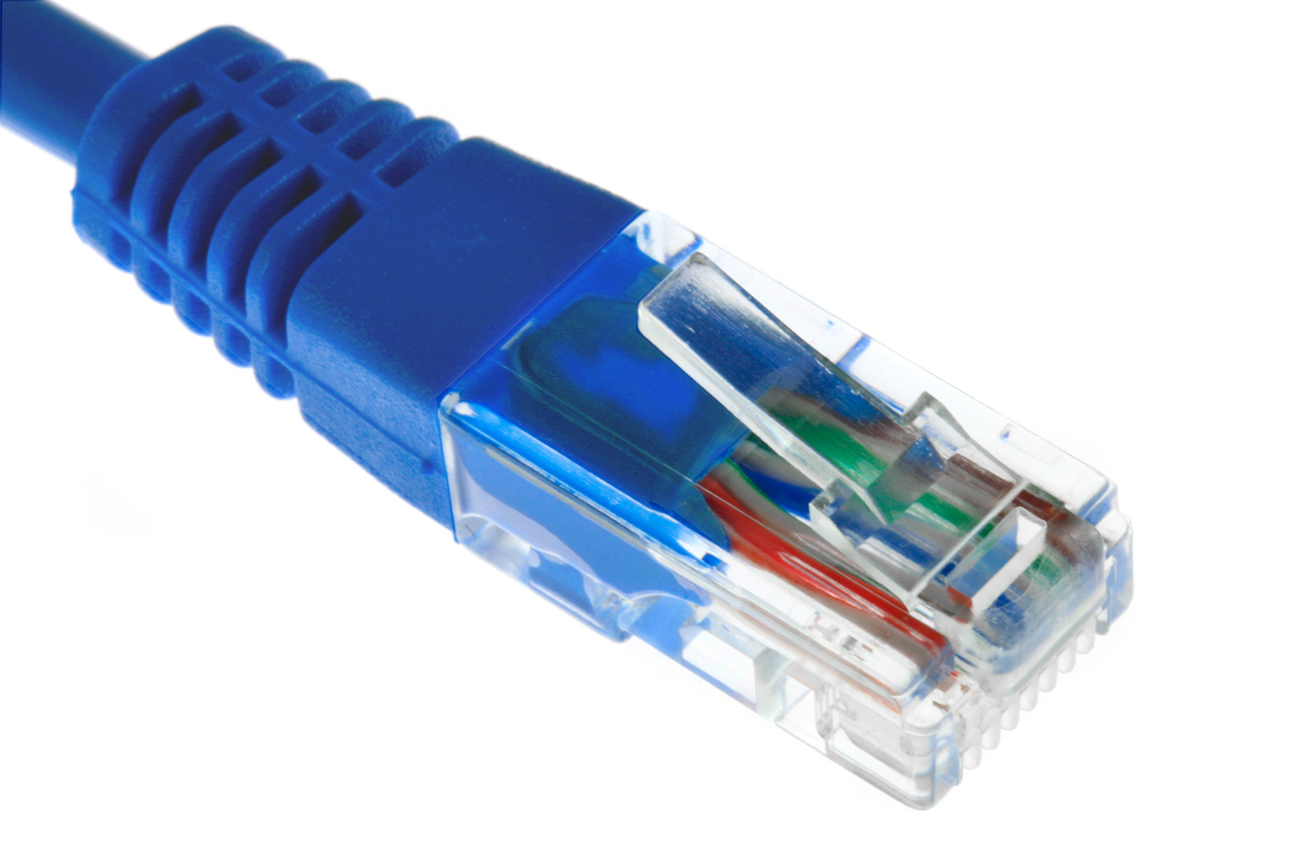

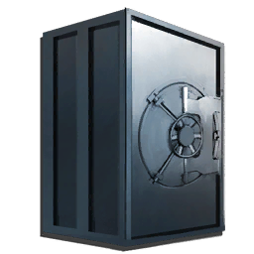



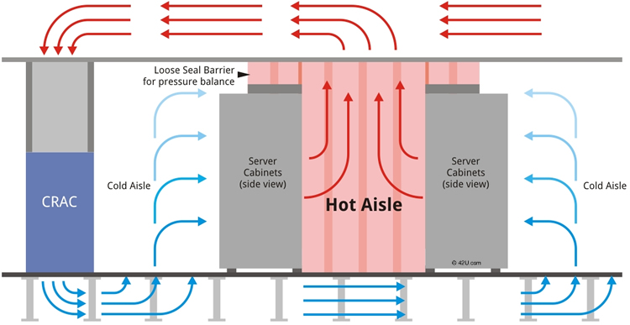
Physical Security – Secure Areas
Air gapped networks/systems
Vaults and safes
Hot isle/cold isle

Slide 8
Physical Security – Secure Areas
Hot isle/cold isle
Notes:
Computer room air conditioning (CRAC) unit is a device that monitors and maintains the temperature, air distribution and humidity in a network room or data

